Slide 1


The case of an intravascular medical device
Modeling the Mission Dimension
MBSE
Lightning
Round
www.incose.org/iw2021/

Slide 2
Authors
José L. Fernández, independent consultant and MBSE methodologist, joselfernandez@telefonica.net
Juan A. Martínez, Universidad de Alcalá (Spain), juanan.martinez@uah.es
Efrén Diez, Universidad de Alcalá (Spain), efren.diez@uah.es
MBSE
Lightning Round
www.incose.org/iw2021/
2

Slide 3
Agenda
The Intravascular Medical Device (IMD) project
The three dimensions of ISE&PPOOA MBSE methodology
The IMD mission dimension goals
Application of the ISE&PPOOA Mission dimension subprocess
IMD context diagram
IMD mission use cases and scenarios
IMD operational needs
IMD interfaces
To conclude
MBSE
Lightning Round
3

Slide 4
The Intravascular Medical Device (IMD) project
This research aims to develop a micrometric-size robotic joint, enabling the creation of micro-robotic complex mechanisms for minimally invasive micro- surgery techniques and in-vivo health treatments.
The robotic joint will contain a micro-motor connected to a new type of long-lasting gearbox.
A very important issue is that the robotic joint (motor + gear) will be wireless powered, thus providing long endurance to any tool or micro-robot activated by it
MBSE
Lightning Round

Slide 5
The three dimensions of ISE&PPOOA MBSE methodology
Mission
Context+scenarios+needs
System
Sys. requirements+functions+parts
Software
Sw requirements+sw components
MBSE
Lightning Round

Slide 6








The IMD mission dimension goals
Based on how the system is used in a context
Identify the operational needs of the diverse actors
Identify the external interfaces
System
MBSE
Lightning Round

Slide 7
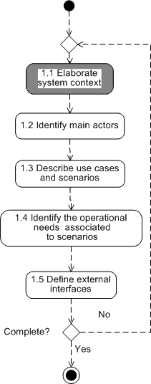
ISE&PPOOA Mission dimension subprocess Step 1. Elaborate system context
The system operates in a context consisting of the environment and other systems.
The Context may be considered as external users,
external systems, natural environment, threats, and resources.
Next slide shows the context of the system represented as an SysML IBD (internal block diagram) where the diverse entities of the context are represented as blocks
The main external interfaces are represented as well
MBSE
Lightning Round

Slide 8
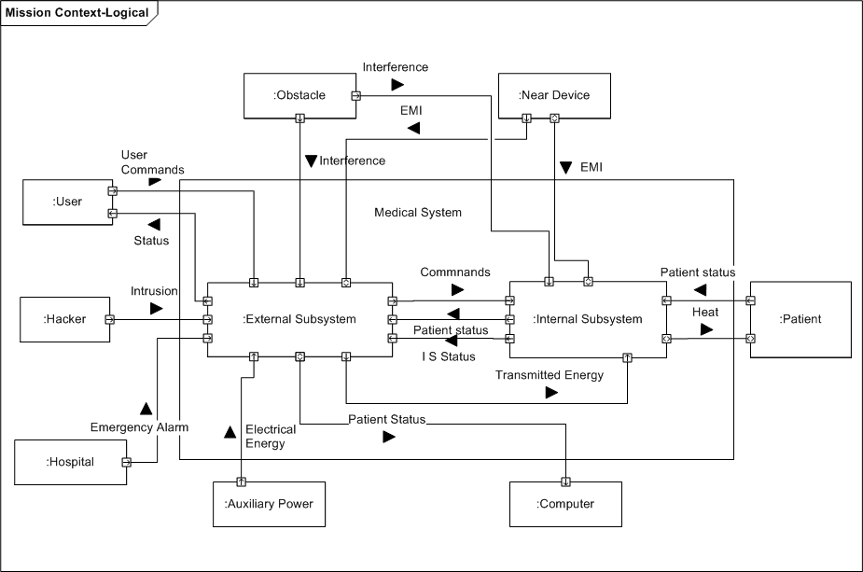
IMD Context Diagram
MBSE
Lightning Round

Slide 9
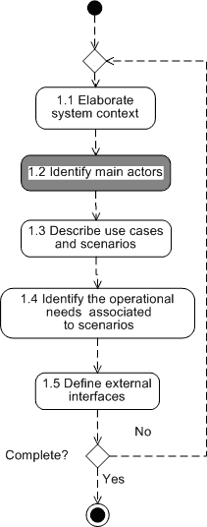
ISE&PPOOA Mission dimension subprocess Step 2. Identify main actors
Based on the context diagram, the main actors (external entities) interacting with the system are identified.
Actors are not only human roles but devices, other systems and the environment
MBSE
Lightning Round

Slide 10
IMD-Actors
User
Hacker
Hospital
Auxiliary power
Computer
Patient
Near device
Obstacle
MBSE
Lightning Round

Slide 11
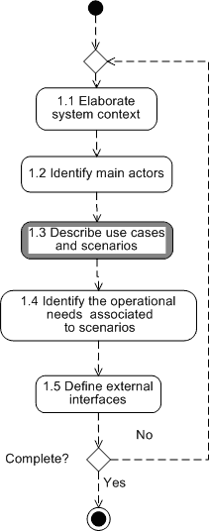
ISE&PPOOA Mission dimension subprocess Step 3. Describe use cases and scenarios
Use cases represented in next slides are the main interactions of the system and the external actors.
Use cases representing safety and security concerns are considered as well. They are labelled CUM (Misuse cases)
A use case may have more than one scenario
Here use cases and their scenarios are described textually using a template.
Other representations such as sequence diagrams or activity diagrams are allowed.
MBSE
Lightning Round

Slide 12
IMD use and misuse cases
Operate on the patient
Diagnose the patient
Communicate patient results
Manage and store results
Prepare the surgical intervention
Report system status
Report system location
Manage power
Report periodically about the implanted system status
Harm the patient
Cause EMI
Prevent communication
Prevent energy transfer
Harm the user
Hack the system
A non-system related medical emergency arises
MBSE
Lightning Round

Slide 13
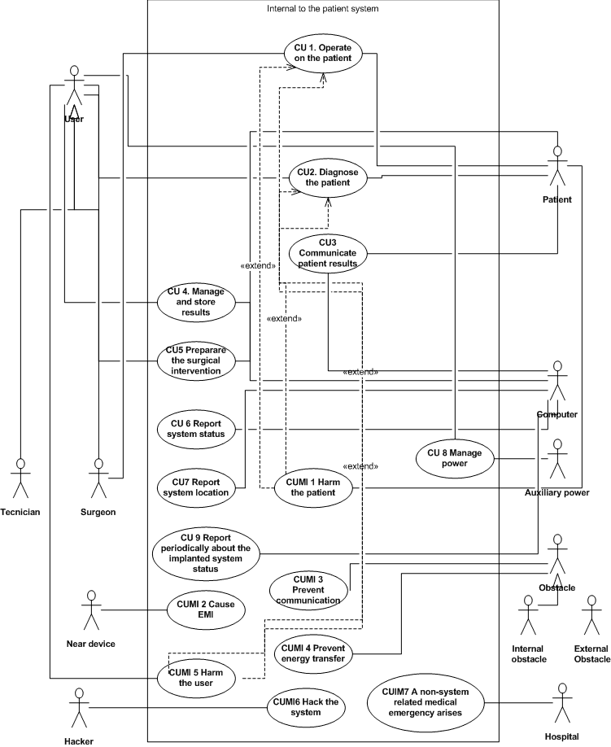
IMD Use cases diagram
MBSE
Lightning Round

Slide 14
IMD- Use Case UC1: Operate on the patient
Scenario 1: The physician perform a surgery only with the system
Scenario 2: Surgery performed using a combination of systems
Scenario 3: (Semi) permanent implantation of the system inside the patient's body.
MBSE
Lightning Round

Slide 15
IMD- Use Case UC1: Operate on the patient- Scenario 1. The physician perform a surgery only with the system
The physician inserts the system inside the patient's body.
The physician guides the system inside the patient's body.
The system transmit its status and position to the physician.
The system transmits that it has arrived at the surgery point.
The physician commands the system to operate.
The system transmits the end of the surgery.
The physician commands the system to comeback to the extraction point.
MBSE
Lightning Round

Slide 16
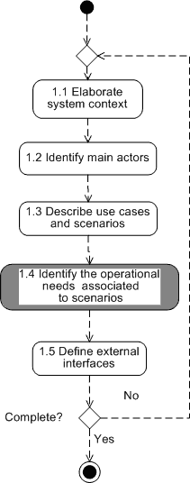
ISE&PPOOA Mission dimension subprocess Step 4. Identify the operational needs associated to scenarios
Here operational needs are defined in the answer to the question “What problem are we trying to solve with the new system operating in a particular context?”
Some authors call them user or stakeholder needs
An operational need may appear in multiple
scenarios
Identify MoEs related to the mission
MBSE
Lightning Round

Slide 17
Operational needs related to UC 1 scenario 1 ( 1 of 3)
ON1.1_1. The surgeon can insert the system inside the patient's body by means of a needle whose diameter is less than 1 +/- 0.1 mm
ON1.1_2. The surgeon can inject the system immersed in saline or other suitable fluid
ON1.1_3. The surgeon can inject the system inside an artery
ON1.1_4. Patient's tissues pressure will not affect the system performance
ON1.1_5. Patient's tissues will not affect chemically the system performance
ON1.1_6. The electrical properties of the patient's tissues will not affect the system performance
ON1.1_7. Patient's temperature will not affect the system performance
ON1.1_8. The surgeon can activate the system motion immediately after the insertion inside the patient's body
ON1.1_9. The surgeon can command the system to move autonomously
ON1.1_10. The surgeon is informed if there is any obstacle which affects the system
motion
MBSE
Lightning Round

Slide 18
Operational needs related to UC 1 scenario 1 ( 2 of 3)
ON1.1_11. The surgeon can command the system to rotate.
ON1.1_12. The surgeon can guide the system manually.
ON1.1_13. The surgeon will know the system position inside the patient's body with an accuracy of
0.1 mm and a precision of 0.1 mm.
ON1.1_14. The surgeon will know the system rotation state using the symmetry axes of the device
as reference with an accuracy of 1 degree and a precision of 1 degree.
ON1.1_15. The surgeon can verify the correct functioning of the system at any time.
ON1.1_16. The surgeon can verify that the system has achieved the surgery point with an accuracy of 0.1 mm and a precision of 0.1 mm.
ON1.1_17. The surgeon can stabilize the system motion with an accuracy of 0.1 mm and a
precision of 0.1 mm.
ON1.1_18. The surgeon can stabilize the system rotation with an accuracy of 1 degree and a precision of 1 degree.
ON1.1_19. The surgeon can command the autonomous stabilization of the system motion with an accuracy of 0.1 mm and a precision of 0.1 mm.
ON1.1_20. The surgeon can command the autonomous stabilization of the system rotation with an accuracy of 1 degree and a precision of 1 degree.
MBSE
Lightning Round

Slide 19
Operational needs related to UC 1 scenario 1 ( 3 of 3)
ON1.1_21. The surgeon can command the activation or deactivation of the system sensors at any time.
ON1.1_22. System data transmission will have a minimum bandwidth of 50 kHz.
ON1.1_23. Surgeon commands to the system will have a minimum bandwidth of 50 kHz.
ON1.1_24. The surgeon can command the activation or deactivation of the system actuators at any time.
ON1.1_25. The surgeon can measure the system surgery duration with an accuracy better than 0.01 s
and a precision better than 0.01 s.
ON1.1_26. The surgeon can command the system to shut down its actuators after the surgery is finished.
ON1.1_27. The surgeon can command the system to detect the surgery completion automatically using its sensors.
ON1.1_28. The surgeon can guide the system manually towards the extraction point with an accuracy of
0.1 mm and a precision of 0.1 mm.
ON1.1_29. The surgeon can command the system to go the extraction point in an autonomous way.
ON1.1_30. The system must be biocompatible with the patient's tissues.
ON1.1_31. The surgeon can fix the duration of the surgery.
ON1.1_32. The surgeon can use the system continuously without any interruption during the whole
duration of the surgery.
MBSE
Lightning Round

Slide 20
Measure of Efficiency (MoE)
An MoE represents a stakeholder expectation that is critical to the success of the system/mission, and failure to attain its critical value, attribute or feature will cause the stakeholder to judge the system/mission a failure (Expanded Guidance for NASA Systems Engineering, 2016)
Example of MoE we identified related to IMD energy: Availability of energy to the device for performing navigation and other functions during the patient
intervention time
MBSE
Lightning Round
www.incose.org/iw2021/

Slide 21
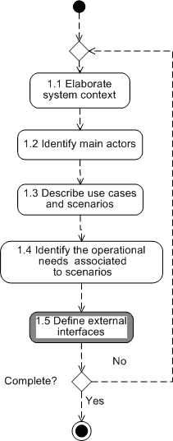
ISE&PPOOA Mission dimension subprocess Step 5. Define external interfaces
The external interfaces identified in the context diagram are described
For data external interfaces we recommend the use of a data dictionary
For mass and/or energy external interfaces we use a template to describe them
MBSE
Lightning Round

Slide 22
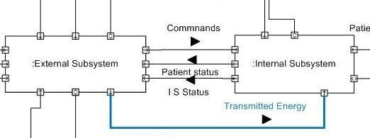
Example of interface- Transmitted Energy 1/2
Transmitted energy interface description: electromagnetic radiation in the range of 2,5 GHz or less with a beam dispersion on the patient's skin no larger than 1 cm in
MBSE
diameter.
Lightning Round

Slide 23
Example of Interface-Transmitted Energy 2/2
Frequency : 2.45 ± 0.05 GHz
Electric field: 100 ± 0.1 V/m
Beam diameter on skin: 10 ± 1 mm
Signal properties: TBD
Electromagnetic effects: TBD
Electromagnetic compatibility: TBD
Electromagnetic interference: TBD
MBSE
Lightning Round
www.incose.org/iw2021/

Slide 24
To conclude
To conclude, we emphasize that a good model of the mission dimension is critical for an “out-in” modeling of a customer-oriented system.
Technology, for example energy transfer and energy harvesting, is an important issue
but in domains as medical applications the users and the patients are more important so “out-in” approaches to the system modeling are the best
option.
MBSE
Lightning Round

Slide 25

www.incose.org/iw2021/
MBSE
Lightning Round

